Slide 1
Flow Field Characterization of Slug Flow Using PIV and CTA Techniques
Teawoo Kim, Eduardo Pereyra and Cem Sarica

Slide 2
Outline
Objectives
Facility design
Fluid properties
Experimental techniques
Two-phase slug flow experimental results
Conclusions

Slide 3
Objectives
Experimental analysis of developing slug body
Is slug flow fully developed for highly viscous condition?
Investigation of velocity field in liquid phase
Investigation of in-situ τ_{W} variations with time and pipe circumference
Measurement of slug characteristics
H_{L}, dp/dL, v_{T}, L_{S}, f_{S}, etc.

Slide 4
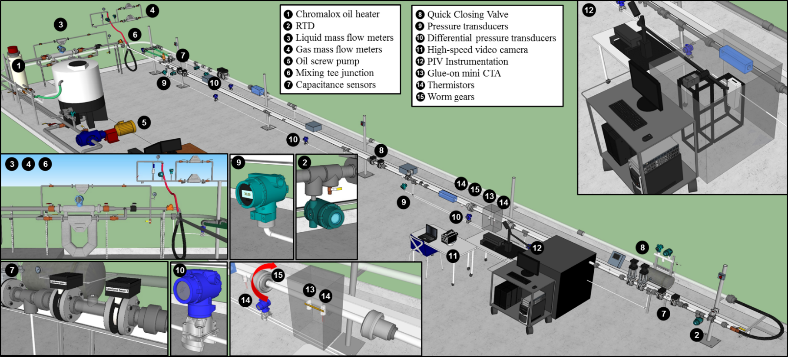
Facility design
PIV Section
CTA Section
Oil storage tank = 3.03 m³
20-hp Kral screw pump
20-kW Chromalox heater
Mass flow meters = Micro Motion Coriolis meters
Liquid = CMF025, CMF100 and CMF300
Gas = CMF025 and CMF050
Pipe ID = 50.8 mm (2 in.)
Pipe length = 21.9 m (72 ft.)
Test section pipe length = 18.9 m (62 ft.)
Pipe material = PVC and Acrylic glass
Notes:
Three pairs of capacitance sensors.

Slide 5
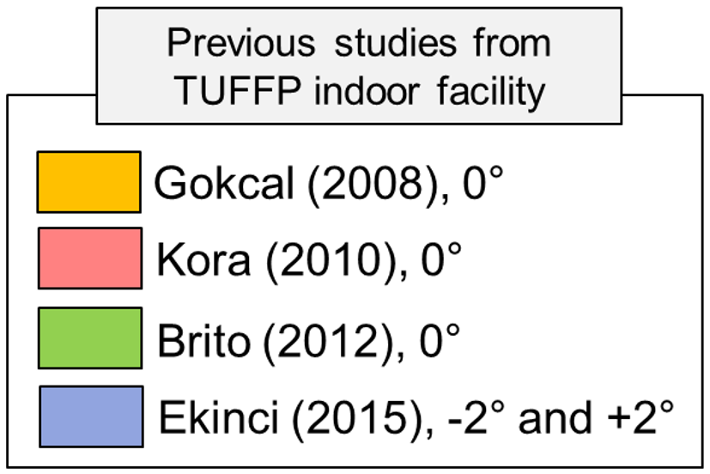
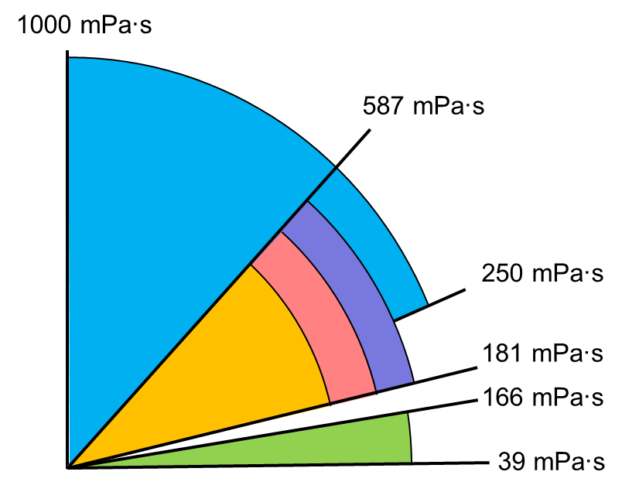
Fluid properties
Synthetic oil (ISO VG 320)
Properties of synthetic oil
Previous two-phase slug flow studies employing PIV
W = Water
A = Air
μ_{L}, (cP) | ρ_{L}, (kg/m³) | σ, (N/m) | Color
510 @ 26.7 °C | 850 @ 26.7 °C | 0.033 | Light yellow
Publisher | Fluids | θ, (°) | Equipment
Hassan et al. (1998) | W – A | 90 | PIV
Polonsky et al. (1999) |  | 90, -90 | PIV with LIF
Van Hout et al. (2002) |  | 90 | PIV
Shemer (2003) |  | 90 | PIV
Nogueira et al. (2003) |  | 90 | PIV with PST and LEDs
Fonseca et al. (2009) |  | 0 | PIV with LIF and PST
Rogero (2009) |  | 0 | PIV with PST and LEDs
Siddiqui et al. (2014) |  | 1.16 | PIV
Siddiqui et al. (2016) |  | 1.16 | PIV
Previous two-phase slug flow studies employing CTA
Publisher | Fluids | θ, (°) | Equipment
Sharma et al. (1998) | W – A | 0 | Hot-film anemometer
Su et al. (2010) | W – A | 0 | Hot-film anemometer
Li et al. (2015) | W – CO₂ | 0 | Floating WSS probe
 | W – A | 0

Slide 6
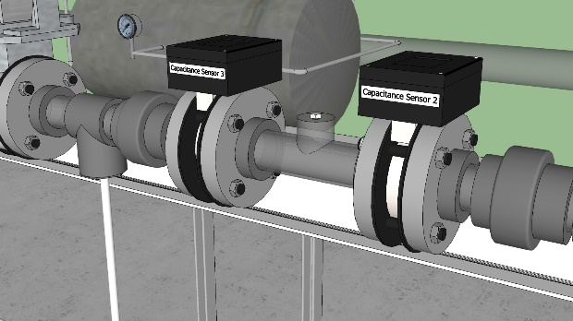
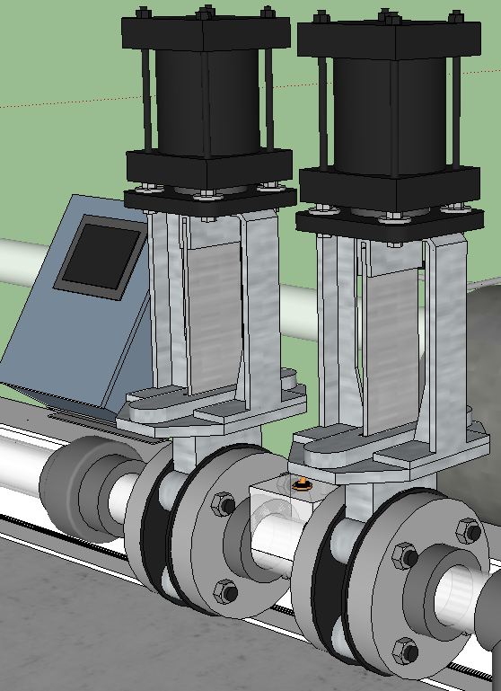
Experimental techniques
Basic instrumentation
Two-wire type capacitance probes (CPs)
H_{L Avg.}, H_{LLS}, H_{LF}, v_{T}, L_{S} and f_{S}.
Kora (2010), Brito (2012) and Kim et al. (2018)
Quick closing valves (QCVs)
Pressure (PTs) and differential pressure transducers (DPs)
Pair of capacitance probes (CPs)
Quick closing valves (QCVs)

Slide 7
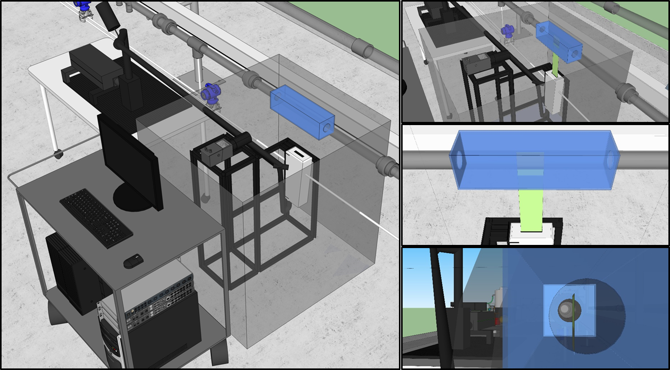
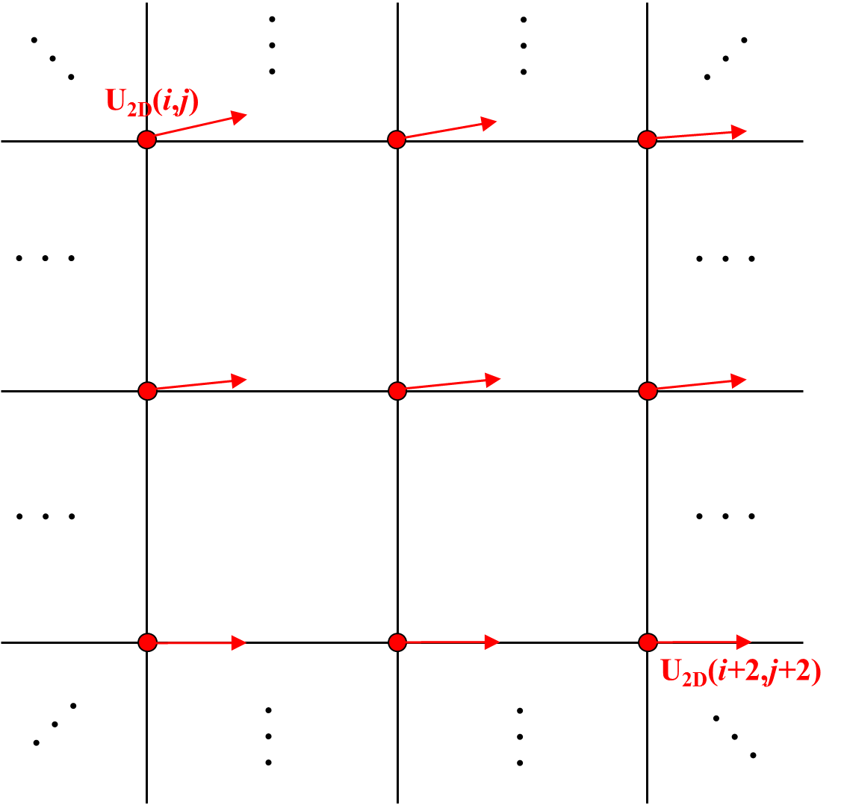
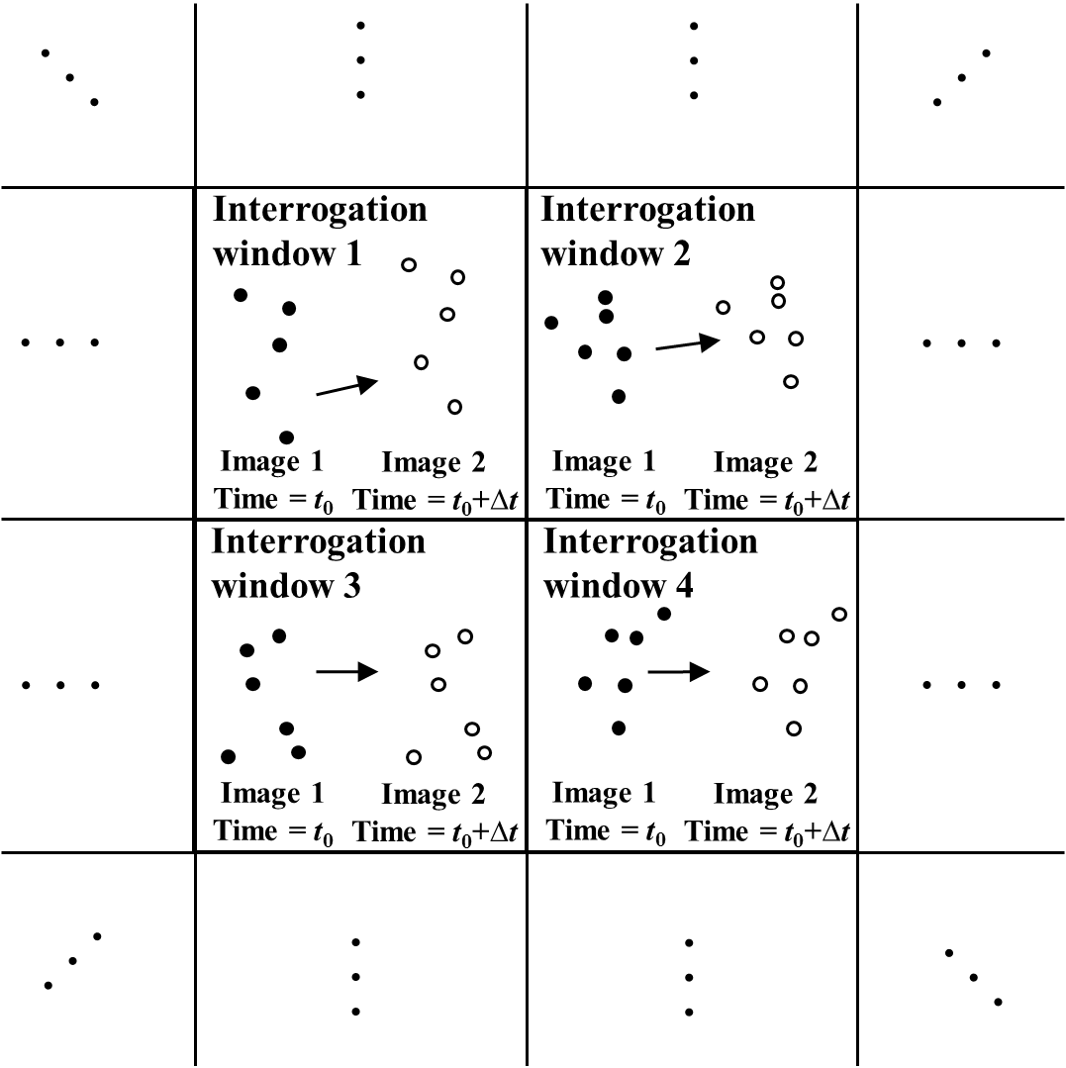
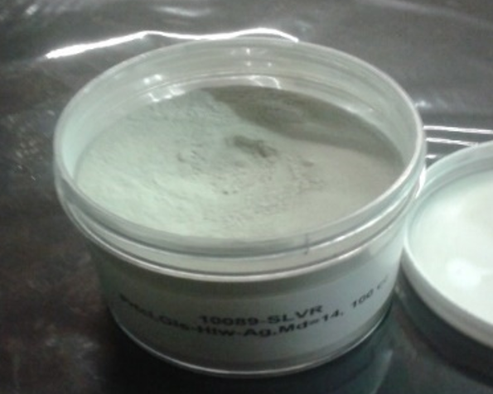
Experimental techniques …
Particle Image Velocimetry (PIV)
Seeding particles (Silver-coated hollow glass spheres)
D = 14 μm, γ = 1.7 kg/m³, U_{p} = 2×10⁻⁷ m/s, f = 4 MHz
Data grid with notation of vectors calculated by two consecutive
images and corresponded cross-correlation (Raffel et al., 2007)

Slide 8
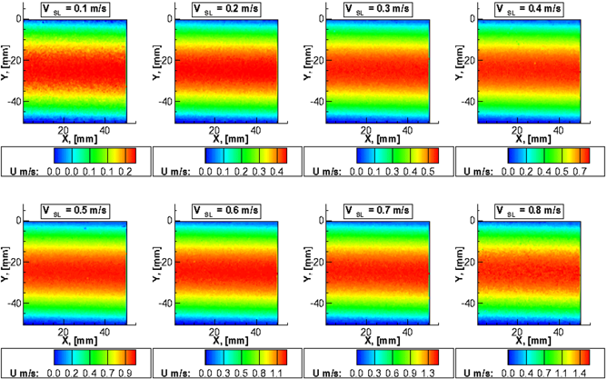
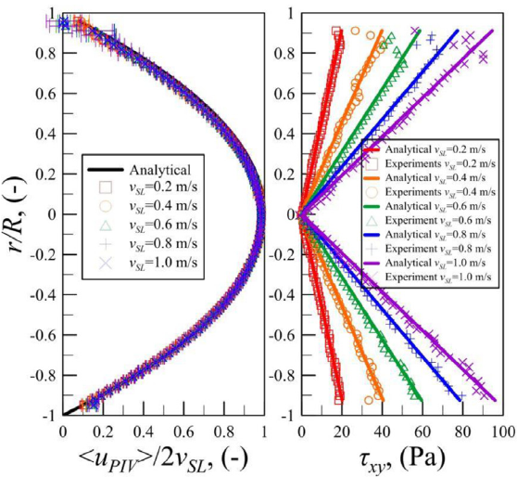
Experimental techniques …
Particle Image Velocimetry (PIV)
Preliminary procedure (Single-phase tests)
Time averaged streamwise velocity fields
(μ_{L} = 680 cP)
Velocity and shear stress profiles comparison
between analytical solution and measured values (ε < ± 4.5%)

Slide 9
Experimental techniques …
Constant Temperature Anemometer (CTA)
Convective heat transfer from the heated sensor to the surrounding fluid
Heat transfer coefficient is primarily related to the fluid velocity
Output voltage is varied with T, μ_{L}, v_{L}, etc. to keep the constant resistance of sensor (wire)

Slide 10
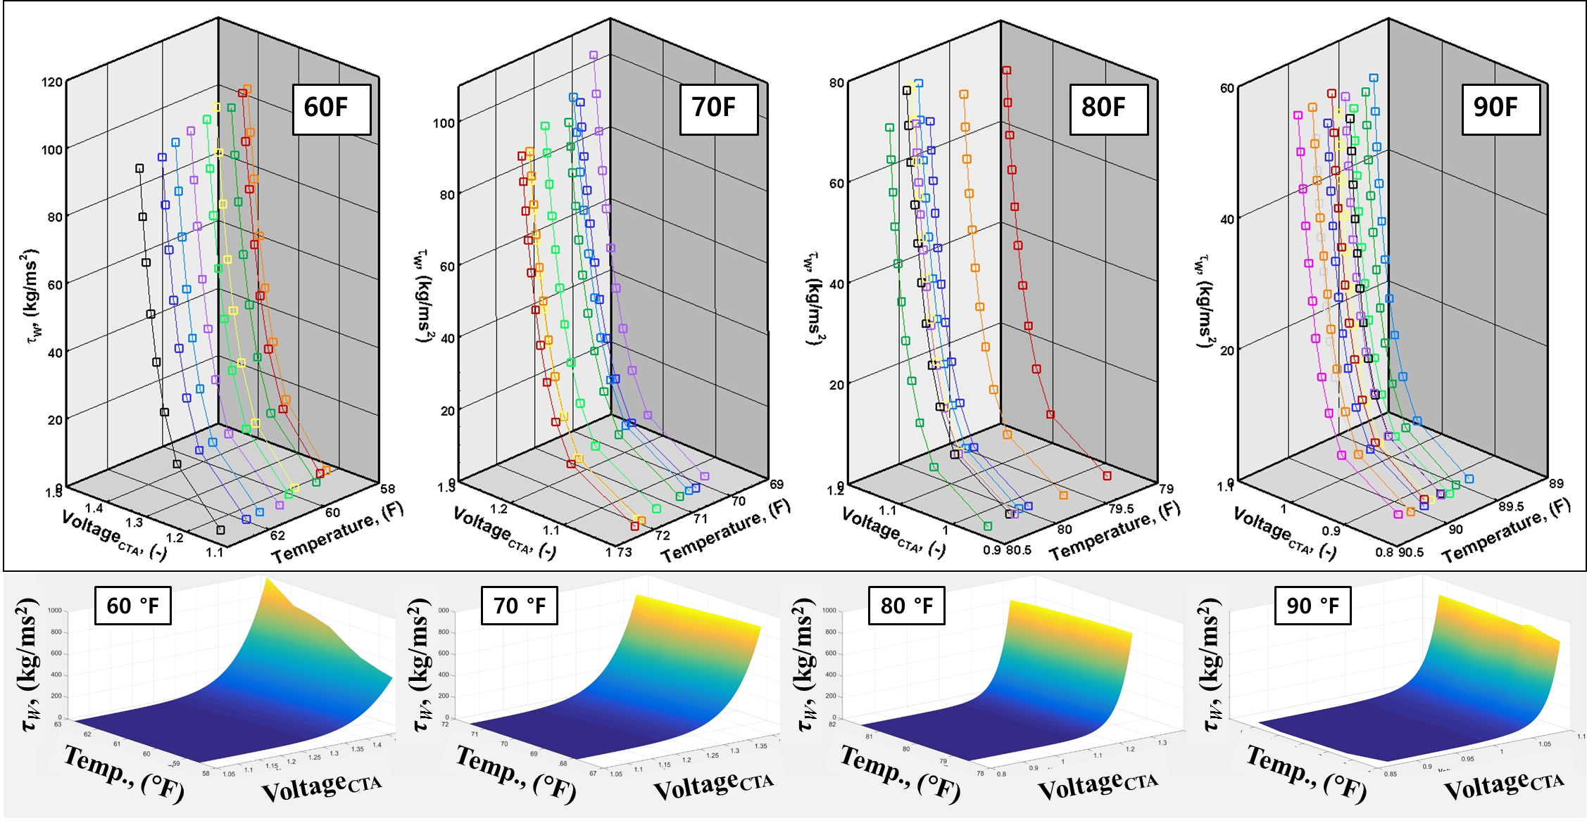
Experimental techniques …
Constant Temperature Anemometer (CTA)
3-D calibration surface with 2-D interpolation

Slide 11
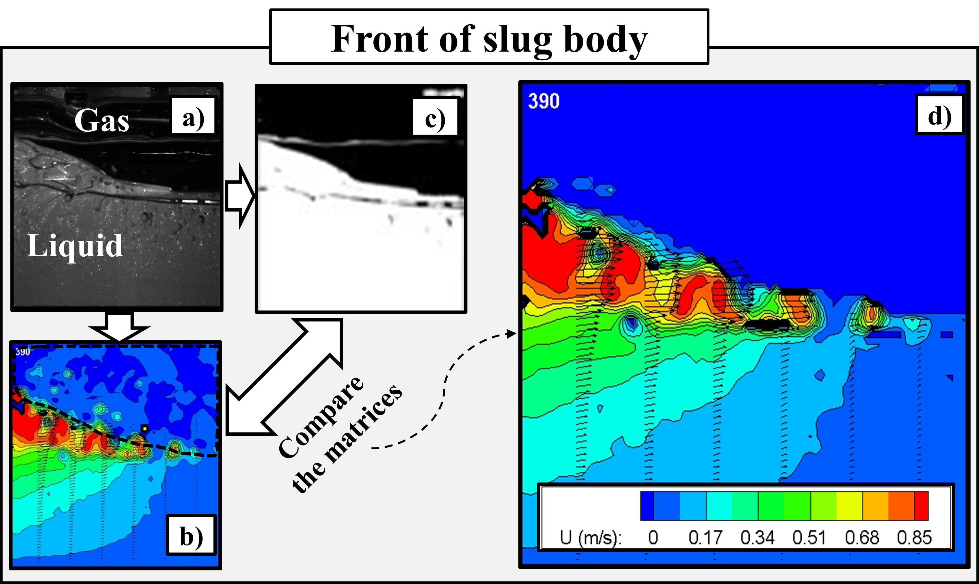
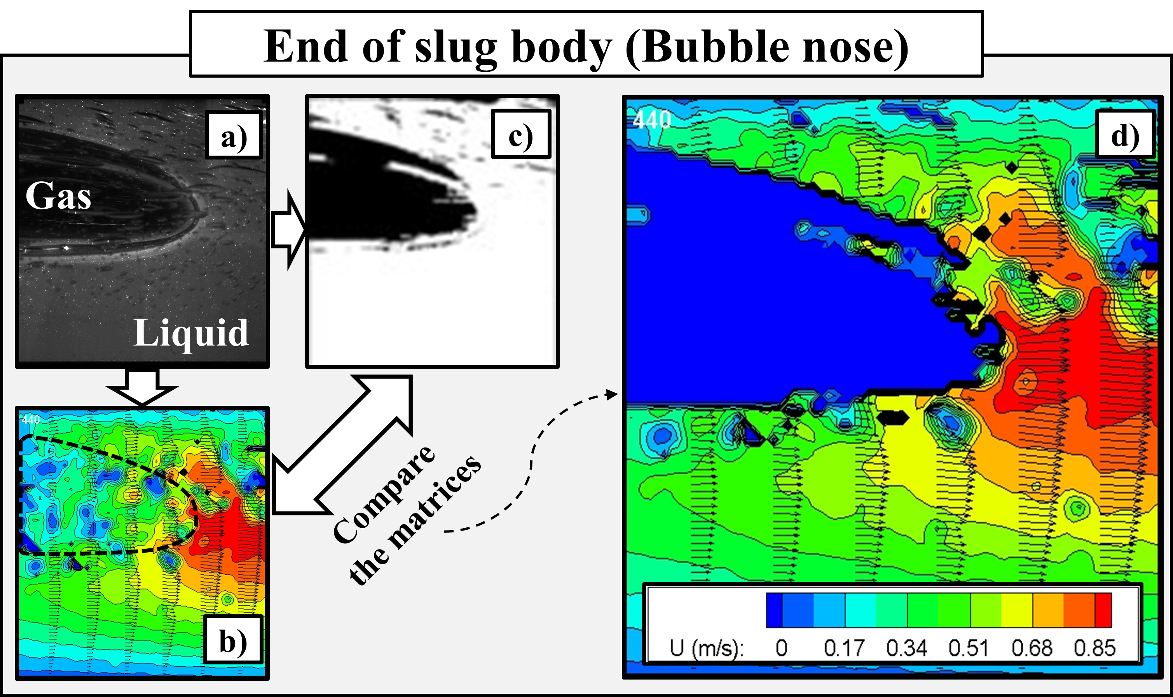
Two-phase experimental results
Particle Image Velocimetry (PIV)
Binary image masking method
a) PIV raw image in slug front and tail,
b) Original post-processed velocity field,
c) Binary image from PIV raw image,
d) Masked velocity field
(v_{SL} = 0.2m/s, v_{Sg} = 0.2m/s and µ_{L} = 680 cP)

Slide 12
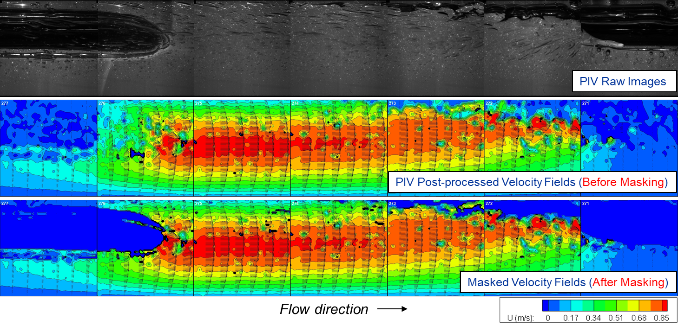
Two-phase experimental results …
Particle Image Velocimetry (PIV)
Liquid phase velocity field
(v_{SL} = 0.2m/s, v_{Sg} = 0.2m/s and µ_{L} = 680 cP)

Slide 13
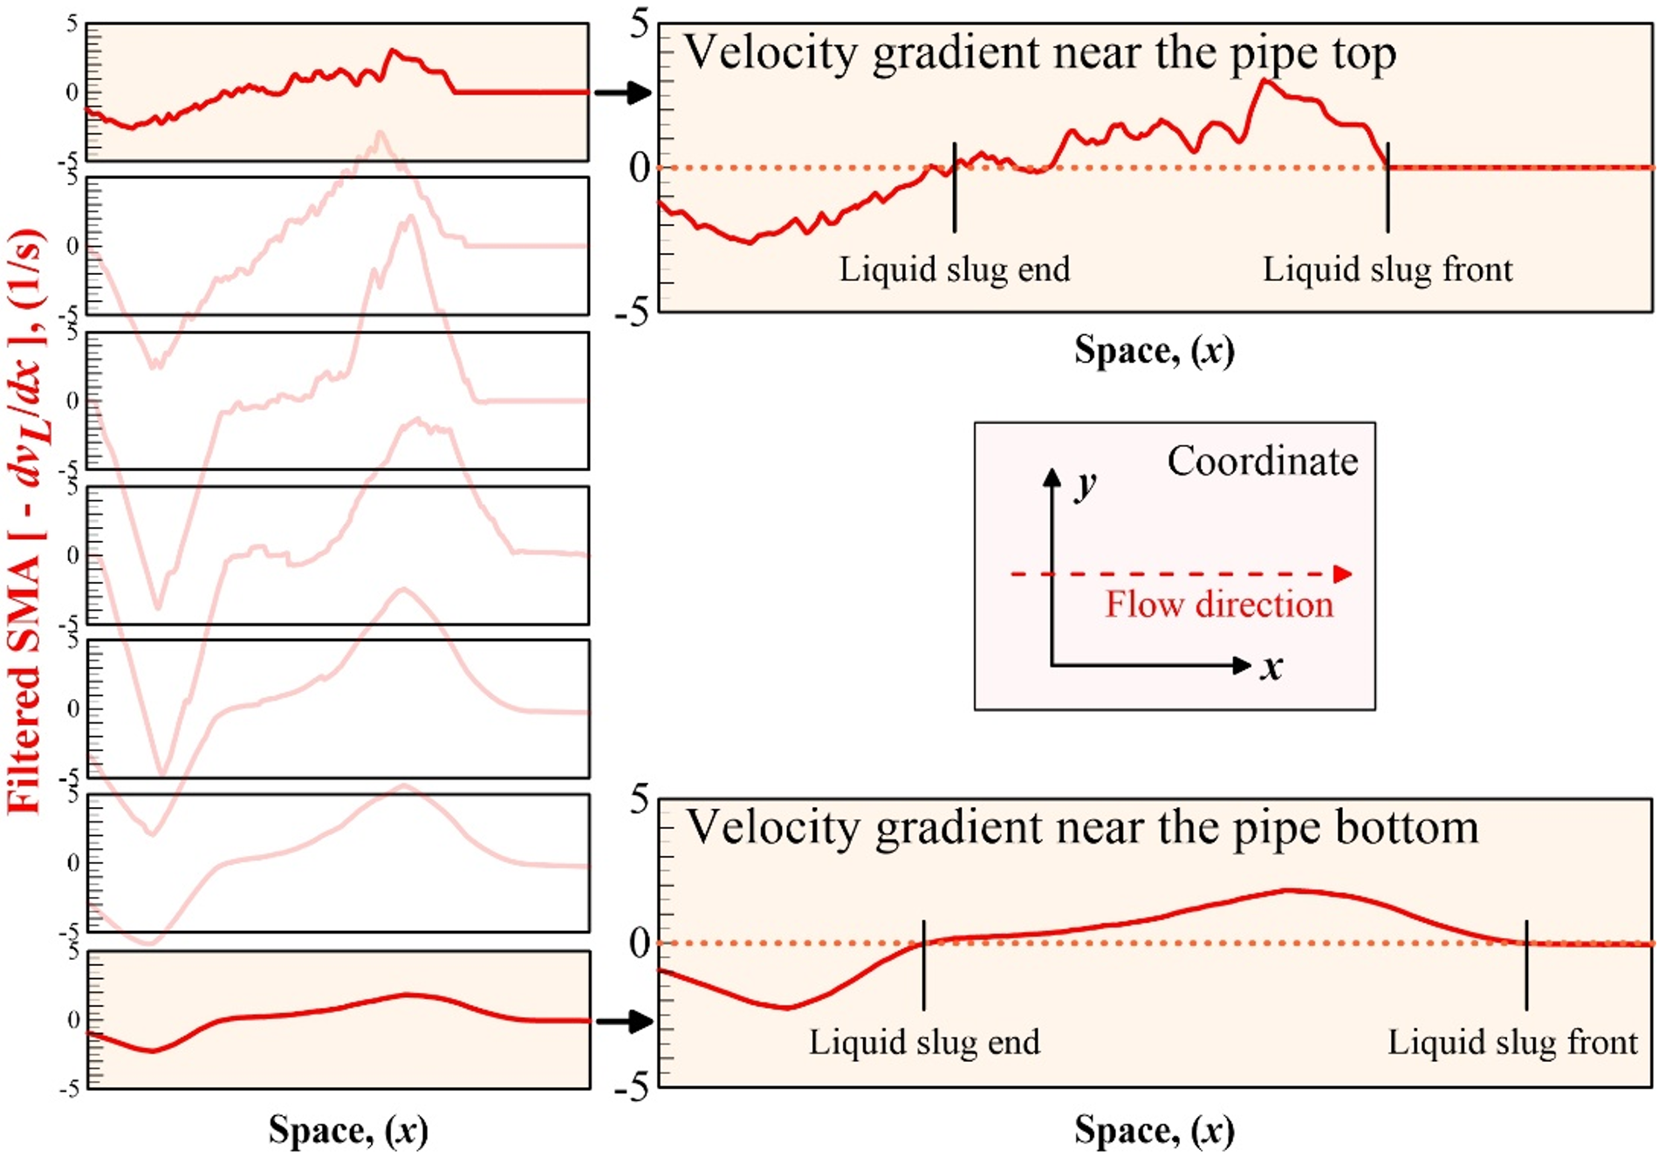
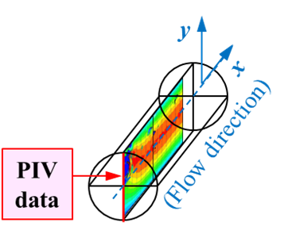
Two-phase experimental results …
Particle Image Velocimetry (PIV)
Liquid velocity gradient from slug front to end at different heights
v_{SL} = 0.2 m/s,
v_{Sg} = 0.2 m/s,
µ_{L} = 680 cP

Slide 14
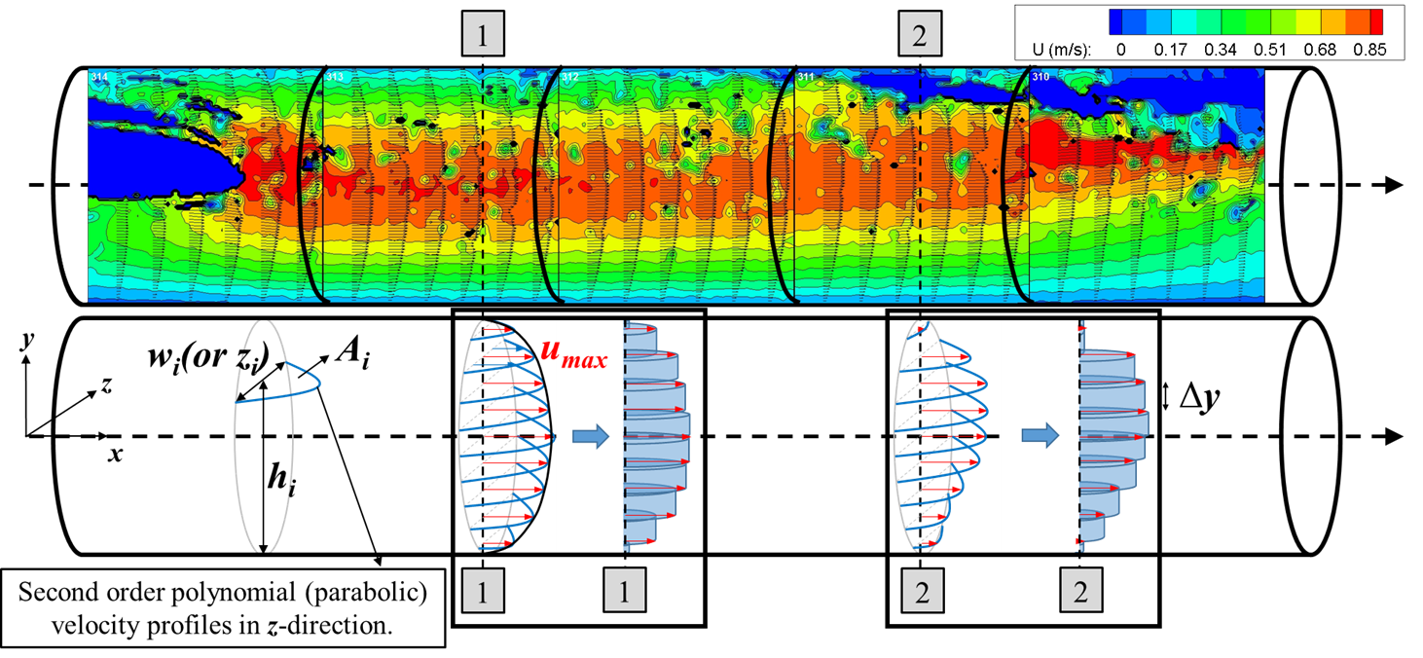
Two-phase experimental results …
Particle Image Velocimetry (PIV)
Calculation of in-situ liquid volumetric flow rate
(v_{SL} = 0.2m/s, v_{Sg} = 0.2m/s and µ_{L} = 680 cP)

Slide 15
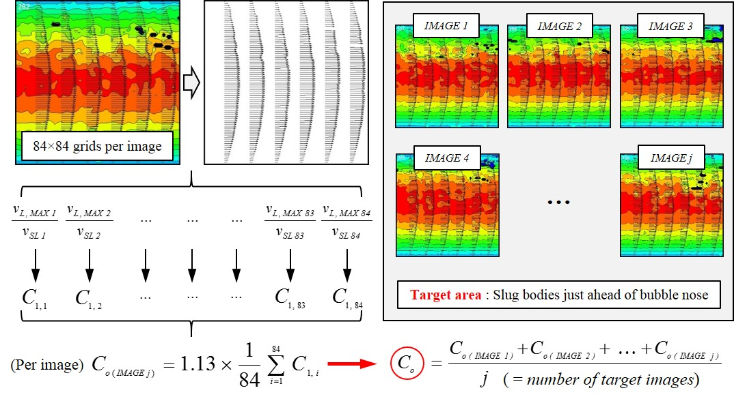
Two-phase experimental results …
Particle Image Velocimetry (PIV)
Estimation of flow coefficient, C₀
Collins et al. (1978) :
Polonsky et al. (1999) :

Slide 16
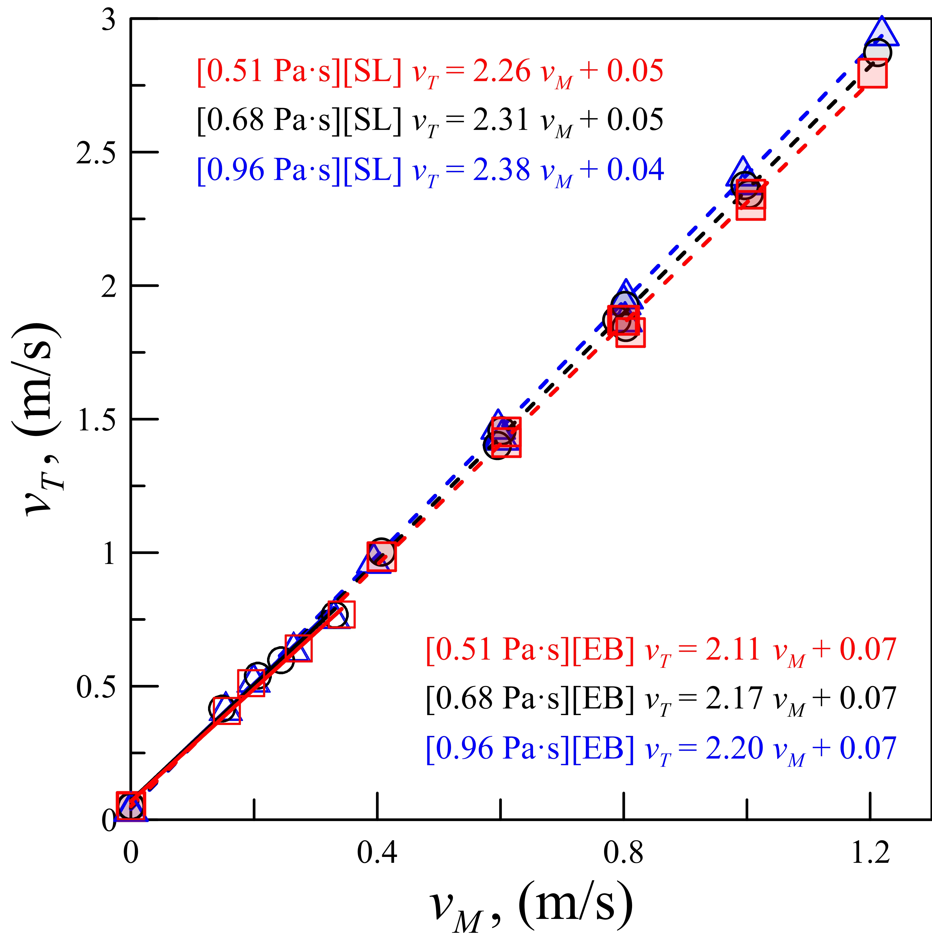
Two-phase experimental results …
Particle Image Velocimetry (PIV)
Results comparison between PIV and CPs
FP | v_{SL} | v_{Sg} | μ_{L} | C₁ | C_{o}
 | (m/s) | (m/s) | (Pa·s) | (-) | (-)
EB | 0.10 | 0.05 | 1.00 | 2.03 | 2.29
EB | 0.10 | 0.10 | 0.99 | 2.03 | 2.29
EB | 0.21 | 0.06 | 0.97 | 2.05 | 2.32
EB | 0.30 | 0.03 | 0.96 | 2.07 | 2.34
SL | 0.20 | 0.20 | 0.97 | 2.07 | 2.34
SL | 0.20 | 0.39 | 0.96 | 2.11 | 2.38
SL | 0.40 | 0.20 | 0.96 | 2.08 | 2.35
SL | 0.40 | 0.40 | 0.96 | 2.15 | 2.43
SL | 0.60 | 0.20 | 0.95 | 2.08 | 2.35
SL | 0.60 | 0.41 | 0.95 | 2.16 | 2.44
FP | v_{SL} | v_{Sg} | μ_{L} | C₁ | C_{o}
 | (m/s) | (m/s) | (Pa·s) | (-) | (-)
EB | 0.10 | 0.05 | 0.70 | 2.02 | 2.28
EB | 0.10 | 0.11 | 0.70 | 2.03 | 2.29
EB | 0.20 | 0.04 | 0.69 | 2.04 | 2.31
EB | 0.30 | 0.03 | 0.69 | 2.07 | 2.34
SL | 0.20 | 0.21 | 0.70 | 2.07 | 2.34
SL | 0.20 | 0.40 | 0.68 | 2.09 | 2.36
SL | 0.40 | 0.20 | 0.69 | 2.08 | 2.35
SL | 0.40 | 0.39 | 0.68 | 2.10 | 2.37
SL | 0.60 | 0.21 | 0.69 | 2.07 | 2.34
SL | 0.60 | 0.41 | 0.68 | 2.11 | 2.38
FP | v_{SL} | v_{Sg} | μ_{L} | C₁ | C_{o}
 | (m/s) | (m/s) | (Pa·s) | (-) | (-)
EB | 0.09 | 0.07 | 0.52 | 2.02 | 2.28
EB | 0.09 | 0.11 | 0.52 | 2.03 | 2.29
EB | 0.21 | 0.07 | 0.52 | 2.05 | 2.32
EB | 0.30 | 0.04 | 0.52 | 2.05 | 2.32
SL | 0.20 | 0.21 | 0.51 | 2.04 | 2.31
SL | 0.20 | 0.41 | 0.53 | 2.04 | 2.31
SL | 0.40 | 0.21 | 0.51 | 2.05 | 2.32
SL | 0.40 | 0.40 | 0.52 | 2.09 | 2.36
SL | 0.60 | 0.21 | 0.50 | 2.06 | 2.33
SL | 0.60 | 0.41 | 0.51 | 2.08 | 2.35
C_{o PIV} = 1.13×C_{1 PIV}
[EB] PIV : 2.28 ~ 2.34 ↔ CPs : 2.11 ~ 2.20
[SL] PIV : 2.31 ~ 2.44 ↔ CPs : 2.26 ~ 2.38

Slide 17
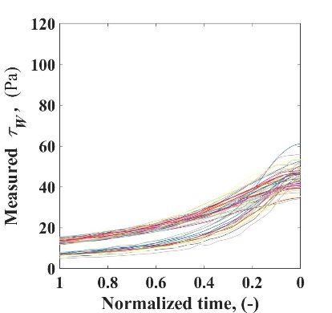
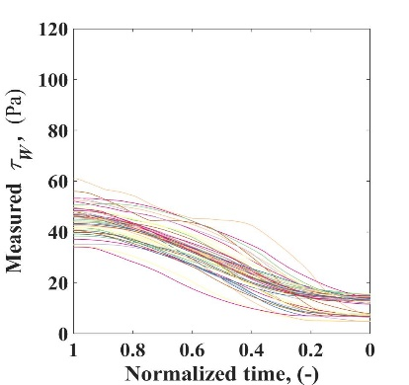
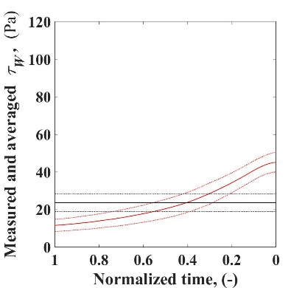
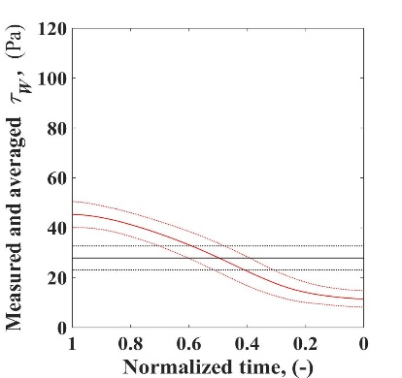
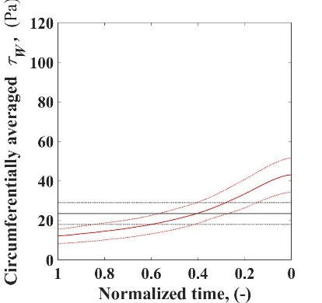
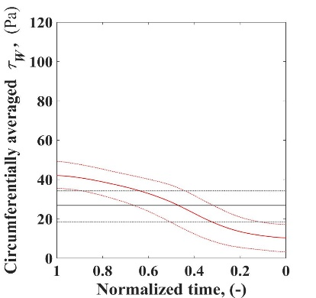
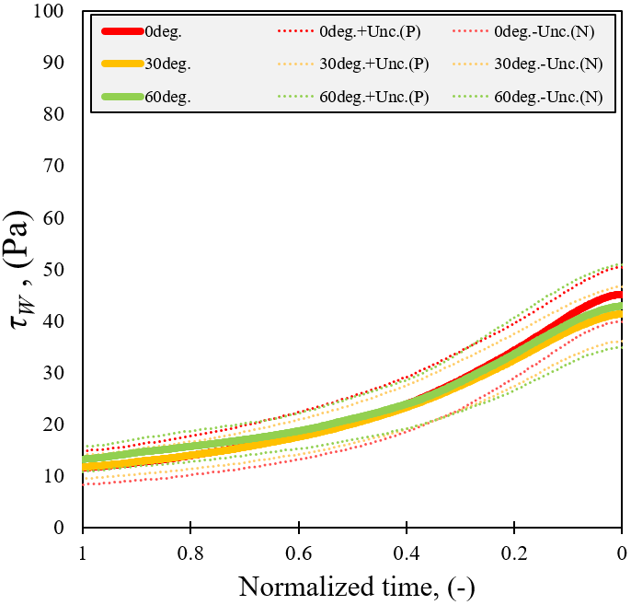
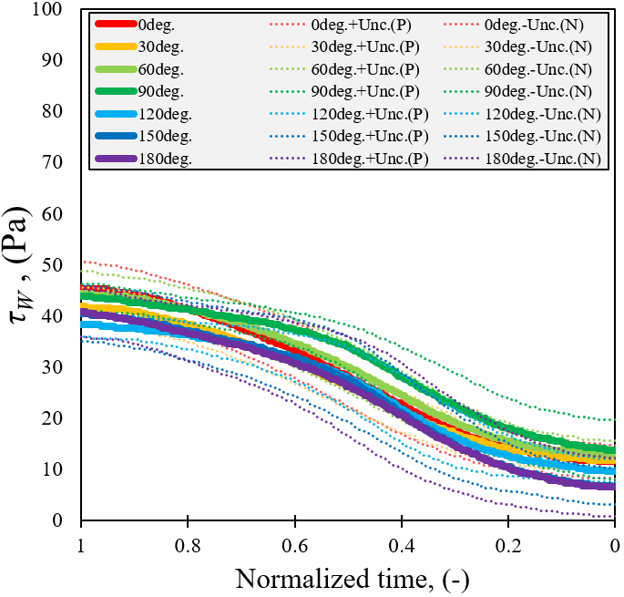
Two-phase experimental results …
Constant Temperature Anemometer (CTA)
ex) v_{SL} = 0.2 m/s, v_{Sg} = 0.4 m/s, µ_{L} = 680 cP @ 0 °
Flow direction
Liquid film
Slug body
Liquid film
Slug body
Liquid film
Slug body
Liquid film
Slug body

Slide 18
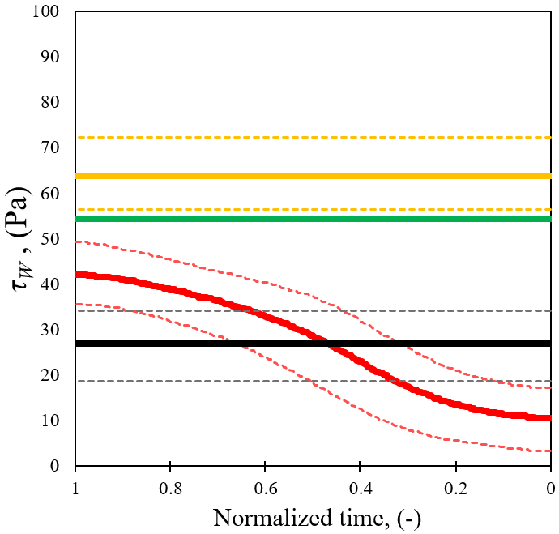
Two-phase experimental results …
Constant Temperature Anemometer (CTA)
Experimental data vs. Dukler and Hubbard (1975)
Slug body
End
Slug body
front
Circumferentially averaged
wall shear stress
Circumferentially and time averaged wall shear stress
[D&H (1975)]
v_{S} measured by PIV,
at the end of slug body
[D&H (1975)]
v_{S} measured by PIV,
averaged from the front to
the end of slug body

Slide 19
Conclusion
PIV and CTA techniques are applied to high viscosity condition
Processing of PIV data is improved by binary image masking method
CTA calibration is enhanced by using 3-D surface
Velocity field is never developed in liquid slug body near the pipe wall
Estimation of in-situ liquid volumetric flow rate is proposed
Calculated values of C₀ are close to 2.3
Wall shear stress is never developed in slug unit
Measured wall shear stress in liquid slug body shows discrepancies from the correlation of Dukler and Hubbard (1975)

Slide 20
Reference
Brito, R., 2012. Effect of medium oil viscosity on two-phase oil-gas flow behavior in horizontal pipes (M.S. Thesis). The University of Tulsa, Tulsa, Oklahoma, USA.
Collins, R., Moraes, F., Davidson, J., Harrison, D., 1978. The motion of a large gas bubble rising through liquid flowing in a tube. Int. J. Fluid Mech. 89 (3), 494-514.
Dukler, A. E., Hubbard, M. G., 1975. A model for gas-liquid slug flow in horizontal and near horizontal tubes. Ind. Eng. Chem. Fundam. 14 (4), 337-347.
Fonseca, R., Barros, J. M., Azevedo, L. F. A., 2009. Liquid velocity field and bubble shape measurements in two-phase horizontal slug flow. In: Proceedings of the 20th International Congress of Mechanical Engineering. Gramado, RS, Brazil, November 15-20.
Gokcal, B., 2008. An experimental and theoretical investigation of slug flow for high oil viscosity in horizontal pipes (Ph.D. Dissertation). The University of Tulsa, Tulsa, Oklahoma, USA.
Hassan, Y. A., Schmidl, W., Villafuerte, J. O., 1998. Investigation of three-dimensional two-phase flow structure in a bubbly pipe flow. Mas. Sci. Techno. 9, 309-326.
Kim, T. W., Aydin, T. B., Pereyra, E., Sarica, C., 2018. Detailed flow field measurements and analysis in highly viscous slug flow in horizontal pipes. Int. J. Multiph. Flow 106, 75-94.
Kora, C., 2010. Effects of high oil viscosity on slug liquid holdup in horizontal pipes (M.S. Thesis). The University of Tulsa, Tulsa, Oklahoma, USA.
Li, W., Xiong, Y., Brown, B., Kee, K. E., Nesic, S., 2015. Measurement of wall shear stress in multiphase flow and its effect on protective FeCO₃ corrosion product layer removal. NACE International Corrosion 2015 Conference & Expo. Dallas, TX, USA, March 15-19.
Nogueira, S., Sousa, R. G., Pinto, A. M. F. R., Riethmuller, M. L., Campos, J. B. L. M., 2003. Simultaneous PIV and pulsed shadow technique in slug flow: a solution for optical problems. Exp. Fluids 35, 598-609.
Polonsky, S., Shemer, L., Barnea, D., 1999. The relation between the Taylor bubble motion and the velocity field ahead of it. Int. J. Multiph. Flow 25, 957-975.
Raffel, M., Willert, C. E., Wereley, S., Kompenhans, J., 2007. Particle image velocimetry. Springer-Verlag, Berlin Heidelberg.
Rogero, E. C., 2009. Experimental investigation of developing plug and slug flows (Ph.D. Dissertation). Technischen Universität München, München, Germany.
Sharma, S. Lewis, S., Kojasoy, G., 1998. Local studies in horizontal gas-liquid slug flow. Nuclear Engineering and Design 184, 305-318.
Shemer, L., 2003. Hydrodynamic and statistical parameters of slug flow. Int. J. Heat Fluid Flow 24, 334.
Siddiqui, M. I., Heikal, M. R., Munir, S., Dass, S. C., Aziz, A. R. A., 2014. Influence of a gas bubble on the dynamical parameters of the slug flow using particle image velocimetry. In: AIP Conference Proceedings, 1621, pp. 691-698.
Siddiqui, M. I., Aziz, A. R. A., Heikal, M. R., 2016. Dynamics of liquid slug using particle image velocimetry technique. In: Proceedings of the 4th International Conference on Fundamental and Applied Science. Kuala Lumpur, Malaysia, August 15-16.
Su, Y., Zhang, M., Zhu, X., Hu, Q., Geng. Y., 2010. Measurements of wall shear stress in horizontal air-water bubbly flows. Flow Measurements and Instrumentation 21, 373-381.
Van Hout, R., Gulitski, A., Barnea, D., Shemer, L., 2002. Experimental investigation of the velocity field induced by a Taylor bubble rising in stagnant water. Int. J. Multiph. Flow 28, 579-596.

